Slide 1

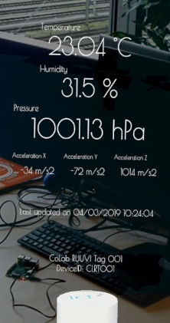
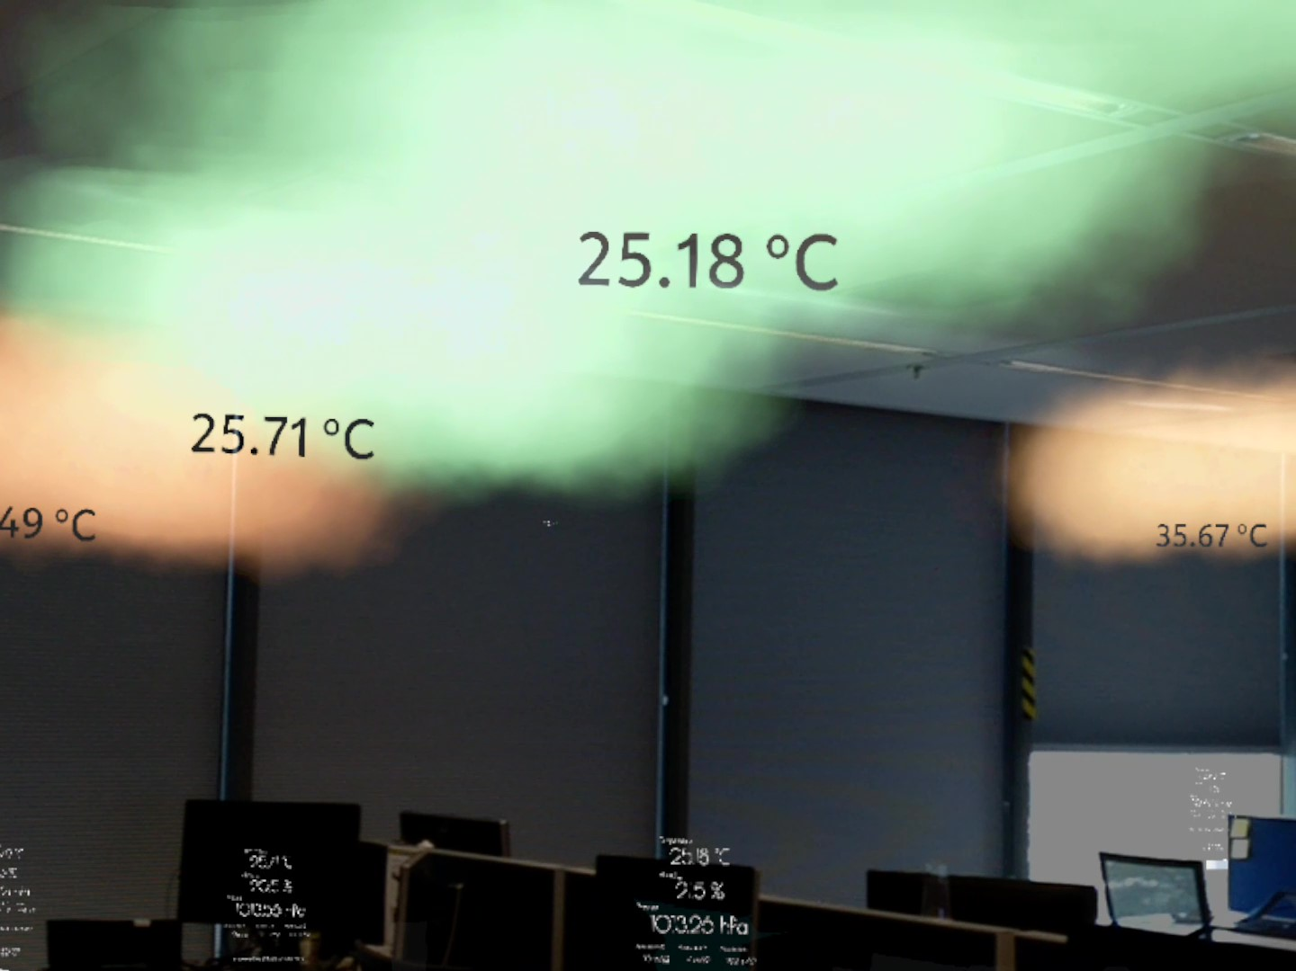







AR Weather Station
AR
For a video demo, please scan the QR code
We created an app that displays the weather inside an office or an indoors space in the form of AR experience. We used 12 RUUVI sensors to collect the telemetry data from different places in the office, send the data to OrangeNXT ConNXT IoT hub. The data is then received the Magic Leap and the UI is adjusted accordingly.
System Architecture and Datapath
12 RUUVI Sensors
Raspberry Pi
ConNXT IoT Hub
Magic Leap
RuuviTag is a waterproof Bluetooth sensor capable of sending temperature, humidity, pressure and motion information directly to any Bluetooth capable device.
Python scripts running on a Raspeberry Pi device that periodically receives the data from all RuuviTags and sends them via Internet to ConNXT.
Each RuuviTag has its own portal configured on ConNXT to easily manage and monitor the device’s readings.
The Magic Leap application reads the telemetry data for each RuuviTag from ConNXT, display them to the user in the form of an interactive menu and an animated heatmap.

